Slide 1
Culture Clash
Storytelling

Slide 2
Why do we tell stories?
To explain the unexplainable
To teach lessons
To uphold traditions and values
To exaggerate our accomplishments and create heroes

Slide 3
Explaining the Unexplainable in Igbo Culture
“Once upon a time all the birds were invited to a feast in the sky…”
Things Fall Apart, 96

Slide 4
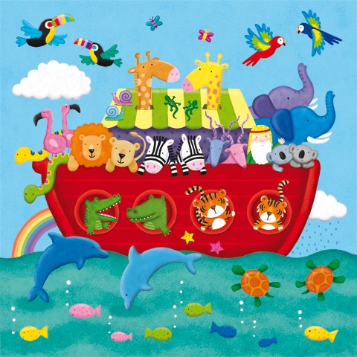
Explaining the Unexplainable in American Culture

Slide 5
Teaching Lessons in Igbo Culture
“Once upon a time all the birds were invited to a feast in the sky…”
Things Fall Apart, 96

Slide 6
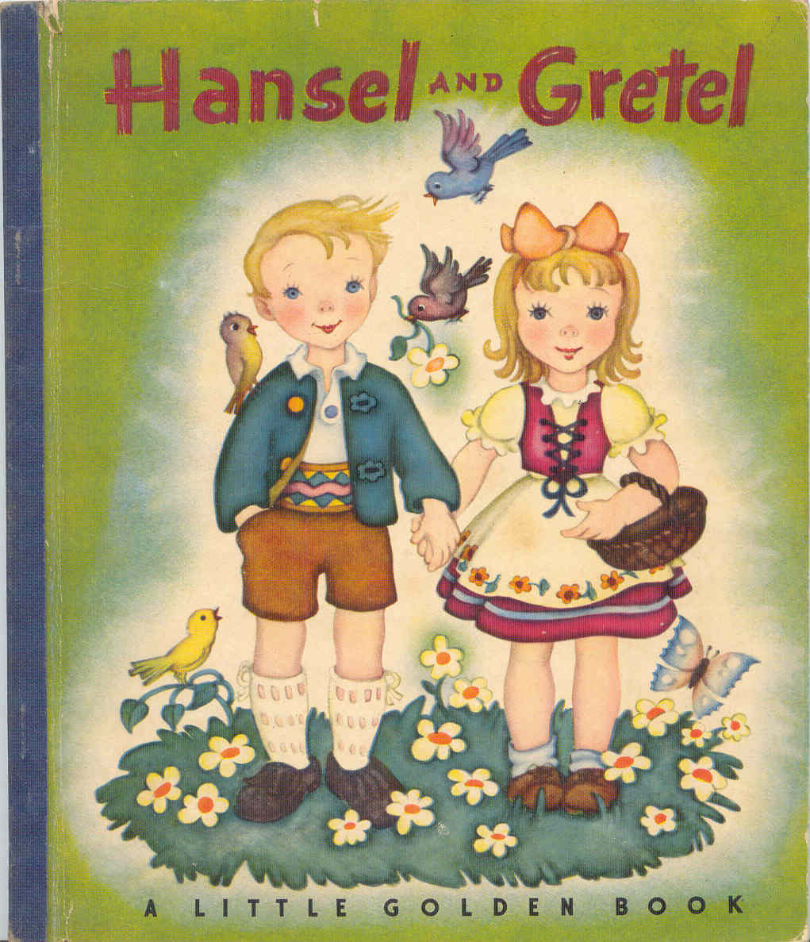
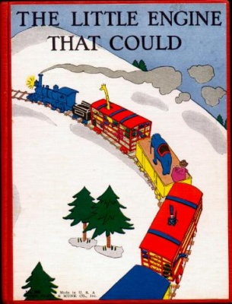
Teaching Lessons in American Culture
“I think I can. I think I can”

Slide 7
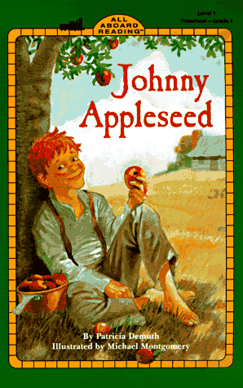
Teaching Lessons in American Culture

Slide 8
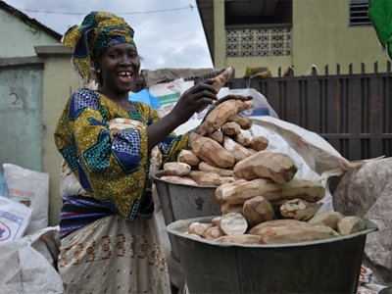
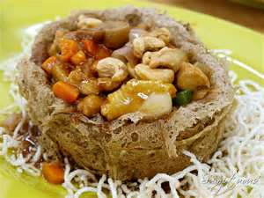
Upholding Traditions in Igbo Culture
“The Story was always told of a wealthy man who set before his
guests a mound of foo-foo so high…”
Things Fall Apart, 37

Slide 9
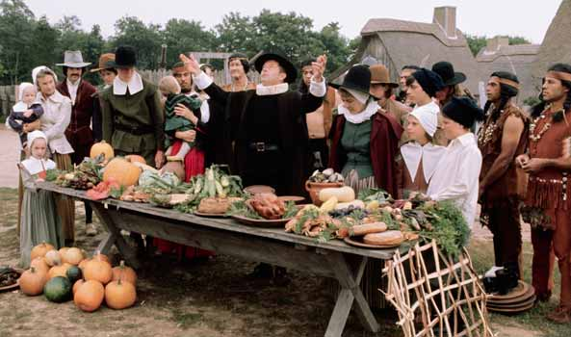
Upholding Traditions in American Culture
“One of the kind Indians was called Squanto, and he came to stay with the Pilgrims, and showed them how to plant their corn, and their peas and wheat and barley.” -The Story of the First Thanksgiving

Slide 10
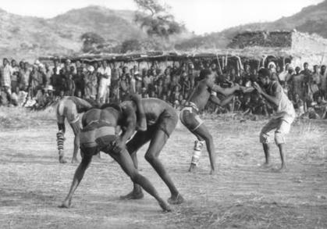
Exaggeration & Hero Creation in Igbo Culture
“Who will wrestle for our village? Okafo will wrestle for our village.
Has he thrown a hundred men? He has thrown four hundred men.”
Things Fall Apart, 51

Slide 11
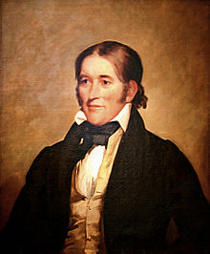
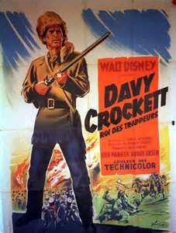
Exaggeration & Hero Creation in American Culture
“Born on a mountain top in Tennessee, greenest state in the Land of the free, raised in the woods so's he knew every tree, kilt him a b'ar when he was only three. Davy, Davy Crockett, King of the wild frontier!”

Slide 12
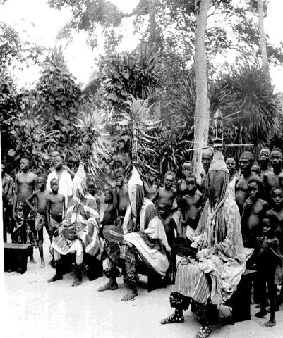
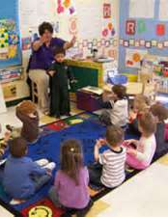

Slide 13
Questions?

